Slide 1
EAPCI White Book
Slide Library
European Heart Agency
23 August 2018

Slide 2
THE EAPCI White Book – Pilot Edition
The EAPCI White Book is the result of a collaboration between EAPCI and the ESC Health Policy Unit with the aim of a systematic mapping on Interventional Cardiology practice in the ESC member countries
It is a unique data set containing data on Interventional Cardiology Practice collected from 16 National Cardiac Societies Interventional Cardiology and Working Groups in Interventional Cardiology
The purpose of the EAPCI White Book is:
To monitor the heterogeneity in practices
To identify obstacles to guideline implementation
To record dynamics of harmonization in Interventional Cardiology practices

Slide 3
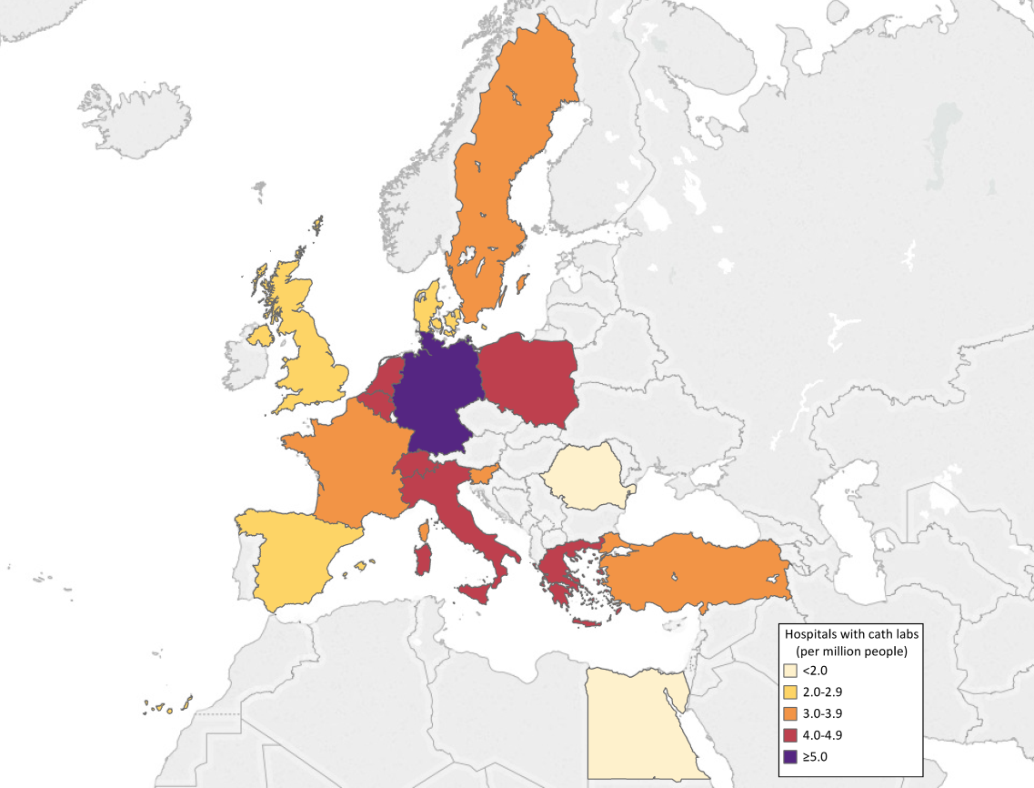
A data collection with focus on interventional cardiology practice
Four main sections:
Health care resources with focus on interventional cardiology
Procedures for coronary interventions
PCI resources
Procedures and resources for structural heart interventions

Slide 4
16 Countries participating
Belgium
Denmark
Egypt
France
Germany
Greece
Italy
Netherlands
Poland
Romania
Slovenia
Spain
Sweden
Switzerland
Turkey
UK

Slide 5
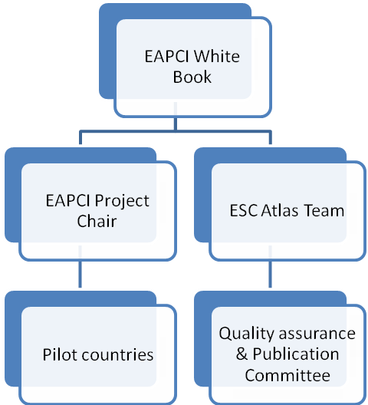
A solid governance to guarantee quality

Slide 6
Data quality assurance
To guarantee the quality of the data, the EAPCI White Book project will follow the same very strict and pre-defined structure of the work plan in place for the ESC Atlas of Cardiology which is described in the following steps:
EAPCI White Book questionnaire: The questionnaire used to collect data was reviewed by internal experts (EAPCI leaders), as well as the ESC Health Policy Unit team.
EAPCI White Book manual: To ensure consistency, it was defined a unique manual based on international definitions of all variables and specifically developed for the EAPCI White Book (harmonised with the definitions used in the ESC Atlas of Cardiology). The EAPCI WB manual was used across National Cardiac Societies of Interventional Cardiology and Working Groups in Interventional Cardiology.
e-CRF based data collection: an electronic data collection form is used to collect data; it contains allot of embodied logical checks and metadata information for data quality purposes.

Slide 7
Data quality assurance
Data cross-reference: Collected data is cross-checked with other data sets collected by ESC Atlas of Cardiology, ESC Associations or available in the literature and other related international sources.
Statistical Validation: Data sets are rigorously processed, checked and validated by a biostatistician using appropriate software and routines
Indicator benchmarking: Comparative indicators are used to identify unusual differences, outliers or non-realistic data
NCS-CS or WG-IC formal approval: Data sets and country profiles are reviewed and approved by NCS-CS or WG-IC prior to finalisation

Slide 8
Deliverables
Electronic database: a comprehensive database, including all the information collected, including the additional information collected.
Country Profiles: Mini standardised reports are available in PDF format and accessible from the website. They describe in a snapshot the general country characteristics, their health care system (as in the ESC Atlas of Cardiology) and provide relevant quantitative and qualitative data extracted from the EAPCI White Book in a structured format. This is the same report as the one included in the E-Atlas with only data related to interventional cardiology.
EAPCI Country data report: A large report available in PDF format with indicators, graphs, charts, maps, comparative analyses based on the entire data set, designed to identify disparities, trends on inequalities, associations and drivers in interventional cardiology in Europe

Slide 9
Deliverables
EAPCI Slide Library: A ready to use collection of Power-point slide sets based on information contained in the benchmarking report, the comparative graphs, charts and maps with the most interesting and important variables and indicators of the EAPCI White Book. This slide deck is designed to be used for presentation purposes by various stakeholders to benchmark countries with each other, to demonstrate trends, associations, statuses, and variability across Europe
E-Atlas and visualisation tool: All data contained in the EAPCI White Book are presented in interactive maps, bar graphs, charts and scatterplots via the data visualization tool: Tableau. The user is able to choose the variables and make the associations of his choice, view and download the graphics.

Slide 10
Bar charts and maps

Slide 11
Health care resources with focus on cardiology

Slide 12
Hospitals with cath labs (per million people), 2016
or latest year
Source: Data on hospitals with cath labs are from the EAPCI White Book database, 2016 (except Netherlands, Turkey: 2017), data on file. Data unavailable: Germany

Slide 13
Hospitals with cath labs (per million people), 2016
or latest year
Source: Data on hospitals with cath labs are from the EAPCI White Book database, 2016 (except Netherlands, Turkey: 2017), data on file. Data unavailable: Germany.

Slide 14
Total cath lab tables (per million people), 2016 or latest year
Source: Data on total cath lab tables are from the EAPCI White Book database, 2016 (except Turkey: 2017), data on file. Data unavailable: Belgium, Netherlands, Poland, Slovenia. Notes: Germany: The numbers of cath lab tables may be higher. For hospitals providing interventional cardiology we counted 1 cath lab table for each

Slide 15
Total cath lab tables (per million people), 2016 or latest year
Source: Data on total cath lab tables are from the EAPCI White Book database, 2016 (except Turkey: 2017), data on file. Data unavailable: Belgium, Netherlands, Poland, Slovenia. Notes: Germany: The numbers of cath lab tables may be higher. For hospitals providing interventional cardiology we counted 1 cath lab table for each

Slide 16
Hospitals with cath labs (per million) versus total cath lab tables (per million), 2016 or latest year
1. Hospital with cath labs. Source: EAPCI White Book database, 2016 (Turkey: 2017), data on file. Data unavailable: Germany. 2. Total cath lab tables. Source: Data on total cath lab tables are from the EAPCI White Book database, 2016 (except Turkey: 2017), data on file. Data unavailable: Belgium, Netherlands, Poland, Slovenia.

Slide 17
Hospitals with cath labs on 24 hours/7 days service (per million people), 2016
Source: Data on hospitals with cath labs on 24 hours/7 days service are from EAPCI White Book database, 2016, data on file. Data unavailable: Romania, Turkey, Germany. Notes: United Kingdom: Defined as labs that are the destination for paramedics diagnosing STEMI in the community.

Slide 18
Hospitals with cath labs on 24 hours/7 days service (per million people), 2016
Source: Data on hospitals with cath labs on 24 hours/7 days service are from EAPCI White Book database, 2016, data on file. Data unavailable: Romania, Turkey, Germany. Notes: United Kingdom: Defined as labs that are the destination for paramedics diagnosing STEMI in the community.

Slide 19
Hospitals with cath labs (per million) versus hospitals with cath labs on 24 hours / 7 days service (per million), 2016 or latest year
The two bars are overlapping, they both start at zero. 1) Hospitals with cath labs. Source: EAPCI White Book database, 2016 (Netherlands, Turkey: 2017), data on file. Data unavailable: Germany 2) Hospitals with cath labs on 24 hours/7 days service). Source: EAPCI White Book database, 2016, data on file. Data unavailable: Romania, Turkey. Notes: United Kingdom: Defined as labs that are the destination for paramedics diagnosing STEMI in the community.

Slide 20
Hospitals with cath labs and on-site cardiac surgery (per million people), 2016 or latest year
Source: Data on hospitals with cath labs and on-site cardiac surgery are from the EAPCI White Book database, 2016 (except Germany: 2017), data on file. Data unavailable: Spain.

Slide 21
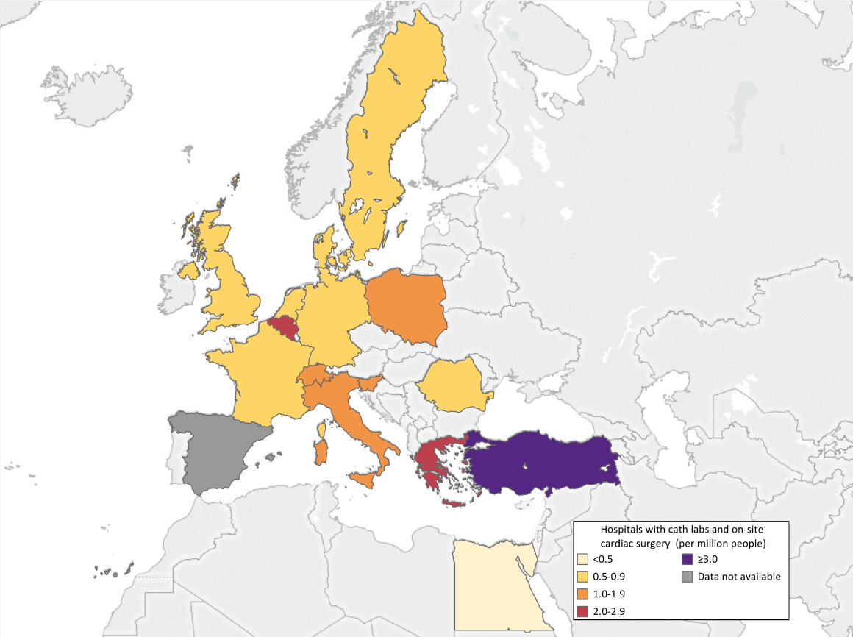
Hospitals with cath labs and on-site cardiac surgery (per million people), 2016 or latest year
Source: Data on hospitals with cath labs and on-site cardiac surgery are from the EAPCI White Book database, 2016 (except Germany: 2017), data on file. Data unavailable: Spain.

Slide 22
Hospitals with cath labs (per million) versus hospitals with cath labs and on-site cardiac surgery (per million), 2016 or latest year
The two bars are overlapping, they both start at zero. 1) Hospitals with cath labs. Source: EAPCI White Book database, 2016 (Netherlands, Turkey: 2017), data on file. Data unavailable: Germany 2) Hospitals with cath labs and on-site cardiac surgery. Source: Data are from the EAPCI White Book database, 2016, data on file. Data unavailable: Spain

Slide 23
Hospitals with cath labs performing structural heart disease interventions in the adult (per million people), 2016
Source: Data on hospitals with cath labs performing structural heart disease interventions in the adult are from the EAPCI White Book database, 2016, data on file. Data unavailable: Germany, Turkey.

Slide 24
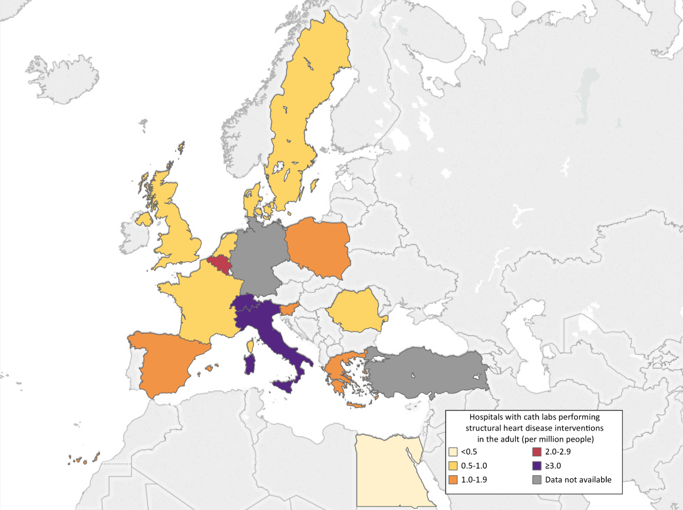
Hospitals with cath labs performing structural heart disease interventions in the adult (per million people), 2016
Source: Data on hospitals with cath labs performing structural heart disease interventions in the adult are from the EAPCI White Book database, 2016, data on file. Data unavailable: Germany, Turkey.

Slide 25
Hospitals with cath labs performing TAVI (per million people), 2016 or latest year
Source: Data on hospitals with cath labs performing TAVI are from the EAPCI White Book database, 2016, (except Germany: 2015; Turkey: 2017), data on file.

Slide 26
Hospitals with cath labs performing TAVI (per million people), 2016 or latest year
Source: Data on hospitals with cath labs performing TAVI are from the EAPCI White Book database, 2016, (except Germany: 2015; Turkey: 2017), data on file.

Slide 27
Hospitals with cath labs performing TAVI (per million) versus hospitals with cath labs performing structural heart disease interventions in the adult (per million), 2016
1) Hospitals with cath labs performing TAVI. Source: EAPCI White Book database, 2016, data on file. 2) Hospitals with cath labs performing structural heart disease interventions in the adult. Source: EAPCI White Book database, 2016, data on file. Data unavailable: Turkey, Germany

Slide 28
Interventional cardiologists (per million people), 2016 or latest year
Source: Data on interventional cardiologists are from the EAPCI White Book database (except Italy: ESC Atlas of Cardiology database), 2016 (except Germany: 2015; Switzerland, Netherlands: 2017), data on file. Note: In Germany there is no difference between interventional and non-interventional cardiologists.

Slide 29
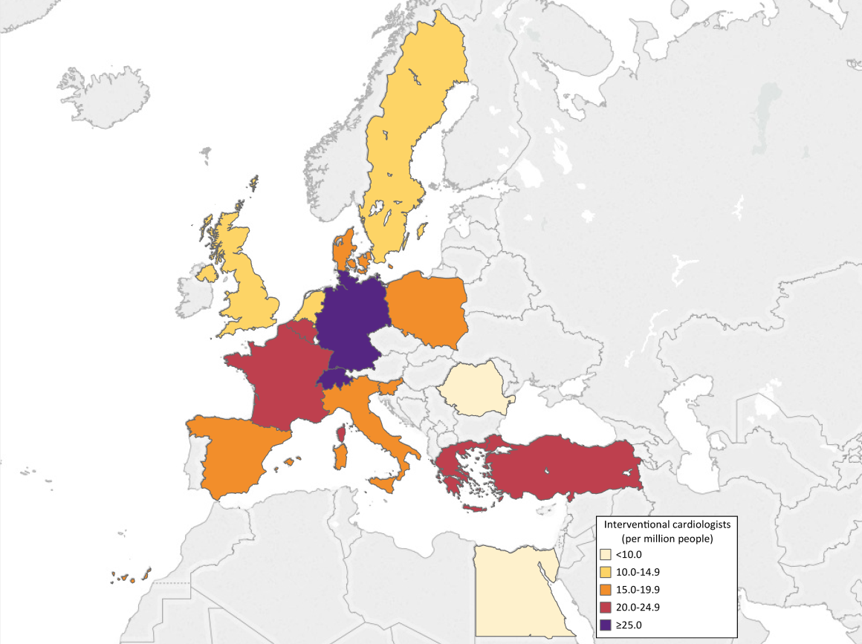
Interventional cardiologists (per million people), 2016 or latest year
Source: Data on interventional cardiologists are from the EAPCI White Book database (except Italy: ESC Atlas of Cardiology database), 2016 (except Germany: 2015; Switzerland, Netherlands: 2017), data on file. Note: In Germany there is no difference between interventional and non interventional cardiologists.

Slide 30
Procedures for coronary interventions

Slide 31
Diagnostic heart procedures (per million people), 2016 or latest year
Source: Data on diagnostic heart procedures are from the EAPCI White Book database, 2016 (except Germany: 2015; Turkey: 2017), data on file. Data unavailable: Belgium, Netherlands. Notes: Germany: Value includes only left heart catheterizations; Greece: Extrapolation based on data representing 97% of total; Romania: Value covers 94% of the public and private interventional cardiology centers in the country; Sweden: Value includes only coronary angiographies.

Slide 32
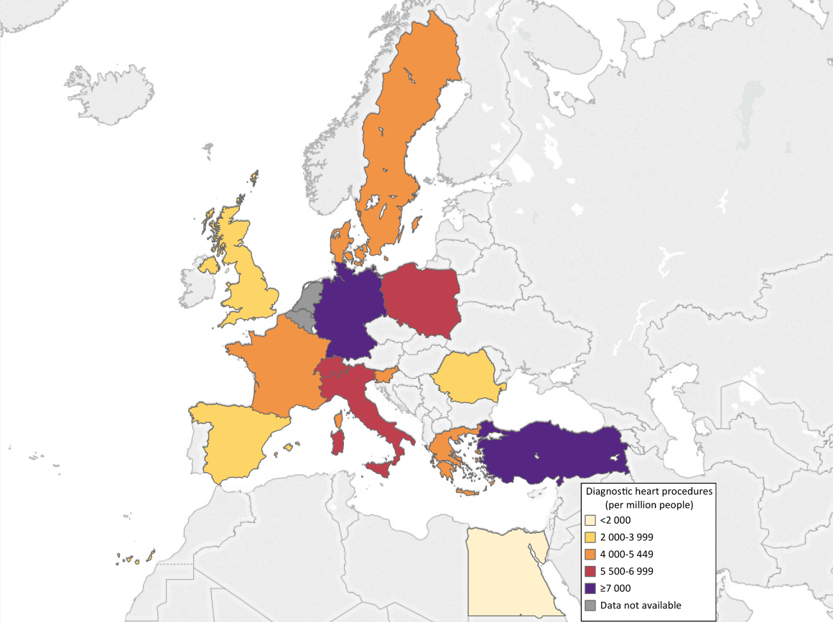
Diagnostic heart procedures (per million people), 2016 or latest year
Source: Data on diagnostic heart procedures are from the EAPCI White Book database, 2016 (except Germany: 2015; Turkey: 2017), data on file. Data unavailable: Belgium, Netherlands. Notes: Germany: Value includes only left heart catheterizations; Greece: Extrapolation based on data representing 97% of total; Romania: Value covers 94% of the public and private interventional cardiology centers in the country; Sweden: Value includes only coronary angiographies.

Slide 33
Percutaneous coronary interventions (PCI) (per million people), 2016 or latest year
Source: Data on percutaneous coronary interventions (PCI) are from the EAPCI White Book database, 2016 (except Germany: 2015; Slovenia, Turkey: 2017), data on file. Notes: Greece: Extrapolation based on data representing 97% of total; Romania: Value covers 94% of the public and private interventional cardiology centers in the country.

Slide 34
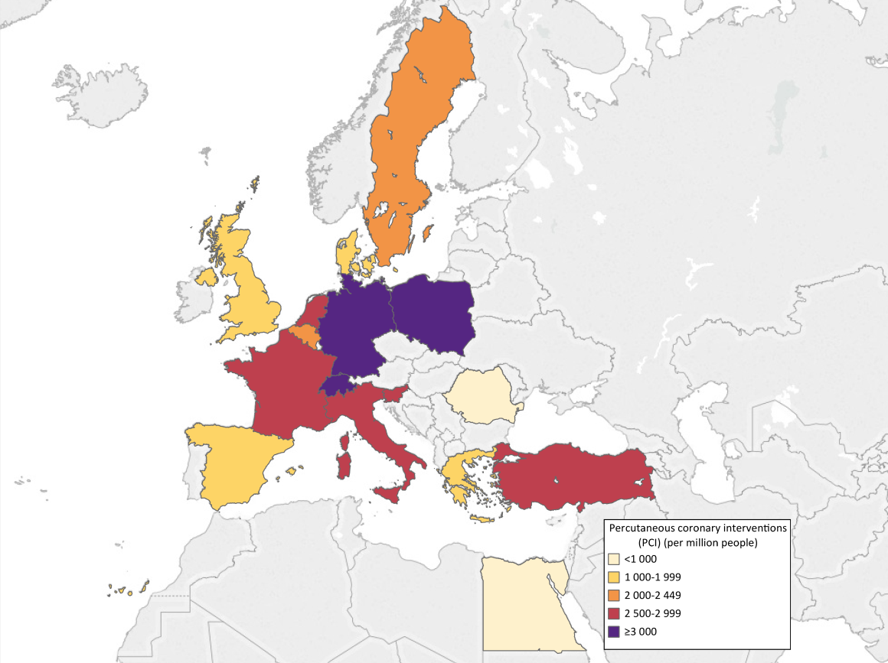
Percutaneous coronary interventions (PCI) (per million people), 2016 or latest year
Source: Data on percutaneous coronary interventions (PCI) are from the EAPCI White Book database, 2016 (except Germany: 2015; Slovenia, Turkey: 2017), data on file. Notes: Greece: Extrapolation based on data representing 97% of total; Romania: Value covers 94% of the public and private interventional cardiology centers in the country.

Slide 35
Percutaneous coronary interventions (PCI) performed by trans-radial access (%), 2016 or latest year
Source: Data on Percutaneous coronary interventions (PCI) performed by trans-radial access (%) are from the EAPCI White Book database, 2016, data on file. Data unavailable: Romania. Notes: Greece: Estimation based on data representing 90% of total.

Slide 36
Percutaneous coronary interventions (PCI) performed by trans-radial access (%), 2016 or latest year
Source: Data on Percutaneous coronary interventions (PCI) performed by trans-radial access (%) are from the EAPCI White Book database, 2016, data on file. Data unavailable: Romania. Notes: Greece: Estimation based on data representing 90% of total.

Slide 37
Primary percutaneous coronary interventions (pPCI) (per million people), 2016 or latest year
Source: Data on primary percutaneous coronary interventions (pPCI) are from the EAPCI White Book database (except Poland: ESC Atlas of Cardiology database), 2016 (except Germany: 2015), data on file. Data unavailable: France, Turkey. Notes :Greece: Estimation based on data representing 90% of total; Romania: Value covers 94% of the public and private interventional cardiology centers in the country.

Slide 38
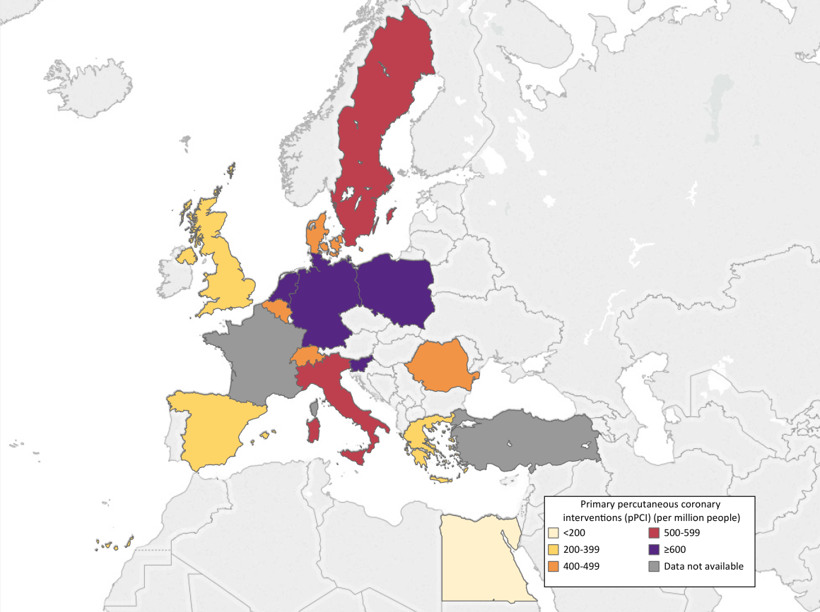
Primary percutaneous coronary interventions (pPCI) (per million people), 2016 or latest year
Source: Data on primary percutaneous coronary interventions (pPCI) are from the EAPCI White Book database (except Poland: ESC Atlas of Cardiology database), 2016 (except Germany: 2015), data on file. Data unavailable: France, Turkey. Notes :Greece: Estimation based on data representing 90% of total; Romania: Value covers 94% of the public and private interventional cardiology centers in the country.

Slide 39
Percutaneous coronary interventions (PCI) (per million) versus primary percutaneous coronary interventions (pPCI) (per million), 2016 or latest year
The two bars are overlapping, they both start at zero. 1) Percutaneous coronary interventions (PCI). Source: EAPCI White Book database, 2016, (except Germany: 2015; Slovenia), data on file. Notes: Greece: Extrapolation based on data representing 97% of total; Romania: Value covers 94% of the public and private interventional cardiology centers in the country. 2) Primary percutaneous coronary interventions (pPCI). Source: EAPCI White Book database (except Poland: ESC Atlas of Cardiology database), 2016, (except Germany: 2015), data on file. Data unavailable: France, Turkey. Notes: Greece: Estimation based on data representing 90% of total; Romania: Value covers 94% of the public and private interventional cardiology centers in the country.

Slide 40
Percutaneous coronary interventions (PCI) in coronary with
chronic total occlusions (CTO) (per million people), 2016 or latest year
Source: Data on percutaneous coronary interventions (PCI) in coronary with chronic total occlusions (CTO) are from the EAPCI White Book database, 2016 (except Germany: 2015), data on file. Data unavailable: Romania, Turkey. Notes: Greece: Extrapolation based on data representing 89% of total.

Slide 41
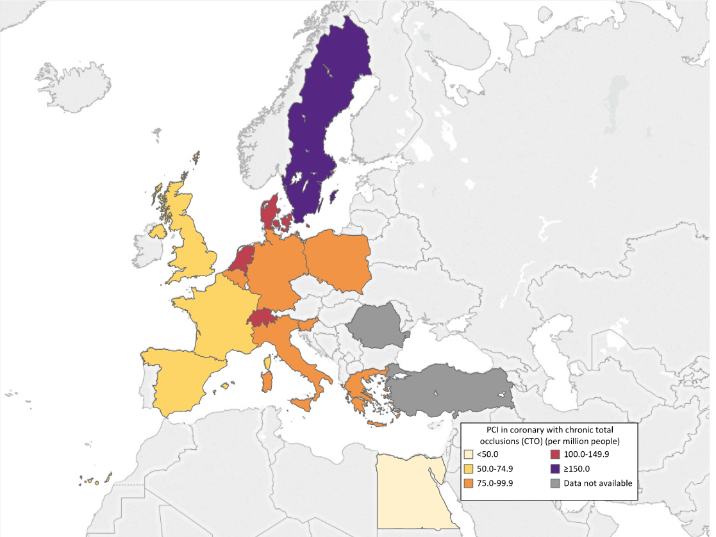
Percutaneous coronary interventions (PCI) in coronary with chronic total occlusions (CTO) (per million people), 2016 or latest year
Source: Data on percutaneous coronary interventions (PCI) in coronary with chronic total occlusions (CTO) are from the EAPCI White Book database, 2016 (except Germany: 2015), data on file. Data unavailable: Romania, Turkey. Notes: Greece: Extrapolation based on data representing 89% of total.

Slide 42
Percutaneous coronary interventions (PCI) in left main (LM) coronary artery (per million people), 2016 or latest year
Source: Data on percutaneous coronary interventions (PCI) in left main (LM) coronary artery are from the EAPCI White Book database, 2016 (except Germany: 2015), data on file. Data unavailable: Egypt, France, Netherlands, Romania, Switzerland, Turkey. Notes: Belgium: Proportion of unprotected left main PCI is unknown; Greece: Extrapolation based on data representing 97% of total.

Slide 43
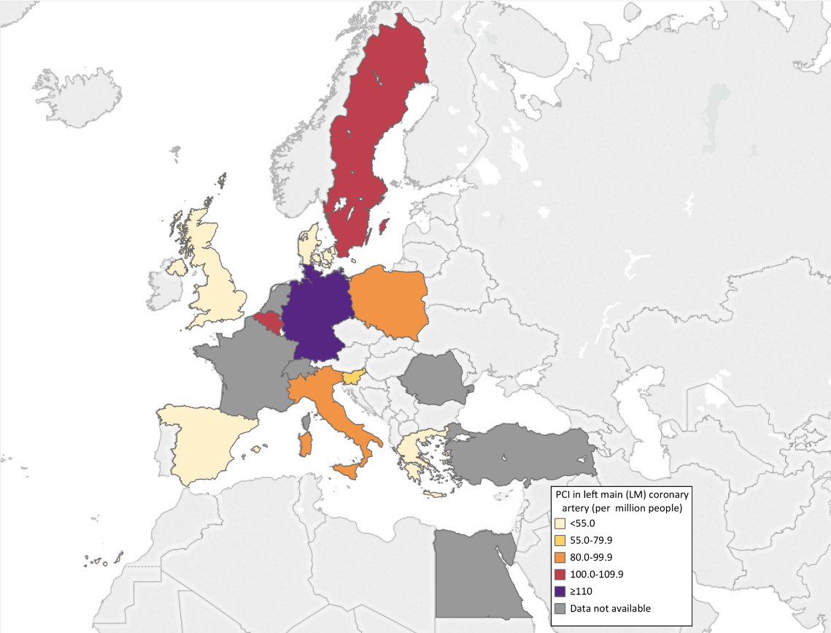
Percutaneous coronary interventions (PCI) in left main (LM) coronary artery (per million people), 2016 or latest year
Source: Data on percutaneous coronary interventions (PCI) in left main (LM) coronary artery are from the EAPCI White Book database, 2016 (except Germany: 2015), data on file. Data unavailable: Egypt, France, Netherlands, Romania, Switzerland, Turkey. Notes: Belgium: Proportion of unprotected left main PCI is unknown; Greece: Extrapolation based on data representing 97% of total.

Slide 44
Percutaneous coronary interventions (PCI) for in-stent restenosis (per million people), 2016 or latest year
Source: Data on percutaneous coronary interventions (PCI) for in-stent restenosis are from the EAPCI White Book database, 2016 (Germany: 2015), data on file. Data unavailable: Egypt, France, Italy, Netherlands, Romania, Switzerland, Turkey. Notes: Greece: Extrapolation based on data representing 76% of total.

Slide 45
Percutaneous coronary interventions (PCI) for in-stent restenosis (per million people), 2016 or latest year
Source: Data on percutaneous coronary interventions (PCI) for in-stent restenosis are from the EAPCI White Book database, 2016 (Germany: 2015), data on file. Data unavailable: Egypt, France, Italy, Netherlands, Romania, Switzerland, Turkey. Notes: Greece: Extrapolation based on data representing 76% of total.

Slide 46
Percutaneous coronary interventions (PCI) without stent (per million people), 2016 or latest year
Source: Data on percutaneous coronary interventions (PCI) without stent are from the EAPCI White Book database, 2016 (except Germany: 2015; Turkey 2017), data on file. Data unavailable: Netherlands, Spain. Notes: Greece: Extrapolation based on data representing 85% of total; Romania: Value covers 94% of the public and private interventional cardiology centers in the country.

Slide 47
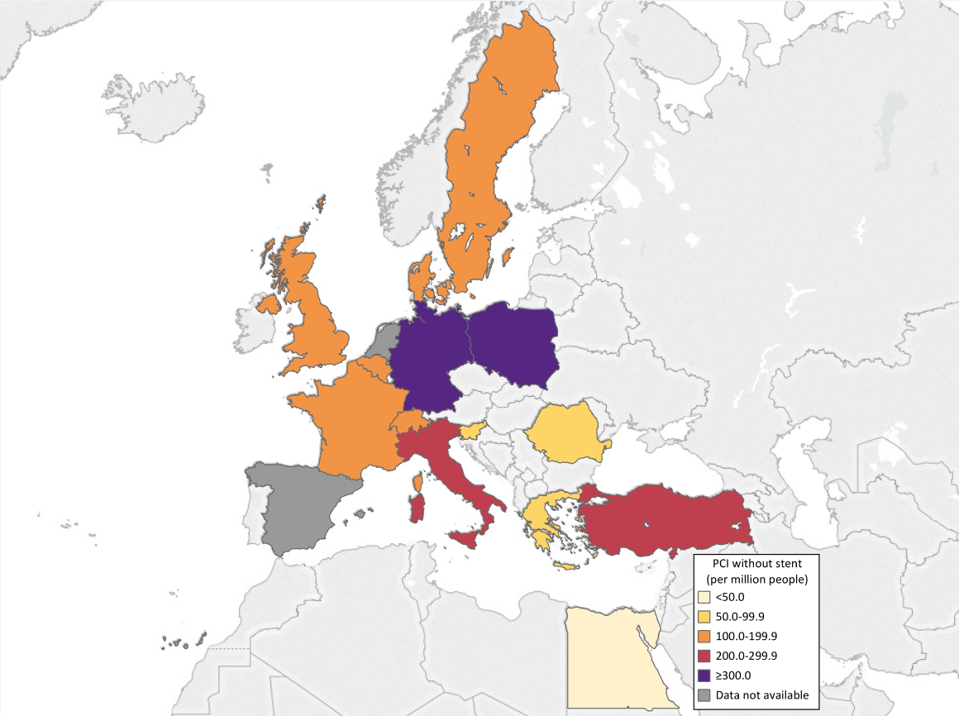
Percutaneous coronary interventions (PCI) without stent (per million people), 2016 or latest year
Source: Data on percutaneous coronary interventions (PCI) without stent are from the EAPCI White Book database, 2016 (except Germany: 2015; Turkey 2017), data on file. Data unavailable: Netherlands, Spain. Notes: Greece: Extrapolation based on data representing 85% of total; Romania: Value covers 94% of the public and private interventional cardiology centers in the country.

Slide 48
Percutaneous coronary interventions (PCI) with drug-eluting balloons (per million people), 2016
Source: Data on percutaneous coronary interventions (PCI) with drug-eluting balloons are from the EAPCI White Book database, 2016, data on file. Data unavailable: Egypt, France, Netherlands, Romania, Turkey, United Kingdom. Notes:Greece: Extrapolation based on data representing 85% of total.

Slide 49
Percutaneous coronary interventions (PCI) with drug-eluting balloons (per million people), 2016
Source: Data on percutaneous coronary interventions (PCI) with drug-eluting balloons are from the EAPCI White Book database, 2016, data on file. Data unavailable: Egypt, France, Netherlands, Romania, Turkey, United Kingdom. Notes:Greece: Extrapolation based on data representing 85% of total.

Slide 50
Percutaneous coronary interventions (PCI) without stent (per million) versus percutaneous coronary interventions (PCI) with drug-eluting balloons (per million), 2016 or latest year
The two bars are overlapping, they both start at zero. 1) Percutaneous coronary interventions (PCI) with drug-eluting balloons. Source: EAPCI White Book database, 2016, data on file. Data unavailable: Egypt, France, Netherlands, Romania, Switzerland, Turkey, United Kingdom. Notes: Greece: Extrapolation based on data representing 85% of total. 2) Percutaneous coronary interventions (PCI) without stent. Source: EAPCI White Book database, 2016 (except Germany: 2015), data on file. Data unavailable: Netherlands, Spain. Notes: Greece: Extrapolation based on data representing 85% of total.

Slide 51
PCI resources

Slide 52
Coronary stents (per million people), 2016
Source: Data on coronary stents are from the EAPCI White Book database, 2016, data on file. Data unavailable: Netherlands, Slovenia, Switzerland, Turkey, Germany. Notes: Greece: Extrapolation based on data representing 97% of total; Romania: Value covers 94% of the public and private interventional cardiology centers in the country; Poland: The number may be higher, as data was reported by 95% of the cathlabs.

Slide 53
Coronary stents (per million people), 2016
Source: Data on coronary stents are from the EAPCI White Book database, 2016, data on file. Data unavailable: Netherlands, Slovenia, Switzerland, Turkey, Germany. Notes: Greece: Extrapolation based on data representing 97% of total; Romania: Value covers 94% of the public and private interventional cardiology centers in the country. Poland: The number may be higher, as data was reported by 95% of the cathlabs.

Slide 54
Coronary drug-eluting stents (per million people), 2016 or latest year
Source: Data on the coronary drug-eluting stents are from the EAPCI White Book database, 2016, data on file. Data unavailable: Netherlands, Switzerland, Turkey, Germany. Notes: Greece: Extrapolation based on data representing 85% of total; Romania: The value covers 94% of the public and private interventional cardiology centers in the country. Poland: The number may be higher, as data was reported by 95% of the cathlabs.

Slide 55
Coronary drug-eluting stents (per million people), 2016 or latest year
Source: Data on the coronary drug-eluting stents are from the EAPCI White Book database, 2016, data on file. Data unavailable: Netherlands, Switzerland, Turkey, Germany. Notes: Greece: Extrapolation based on data representing 85% of total; Romania: The value covers 94% of the public and private interventional cardiology centers in the country. Poland: The number may be higher, as data was reported by 95% of the cathlabs.

Slide 56
Coronary stents (per million) versus coronary drug-eluting stents (per million) , 2016 or latest year
The two bars are overlapping, they both start at zero. 1) Coronary stents. Source: EAPCI White Book database, 2016, data on file. Data unavailable: Netherlands, Slovenia, Switzerland, Turkey, Germany. Notes: Greece: Extrapolation based on data representing 97% of total; Romania: Value covers 94% of the public and private interventional cardiology centers in the country. Poland: The number may be higher, as data was reported by 95% of the cathlabs. 2) Coronary drug-eluting stents. Source: EAPCI White Book database, 2016, data on file. Data unavailable: Netherlands,
Switzerland, Turkey, Germany. Notes: Greece: Extrapolation based on data representing 85% of total; Romania: The value covers 94% of the public and private interventional cardiology centers in the country. Poland: The number may be higher, as data was reported by 95% of the cathlabs.

Slide 57
Coronary bio-resorbable vascular scaffolds (per million people), 2016
Source: Data on coronary bio-resorbable vascular scaffolds are from the EAPCI White Book database, 2016, data on file. Data unavailable: Egypt, Switzerland, Turkey. Notes: Spain: This is the number of procedures with at least one bio-resorbable vascular scaffold implanted; France: Procedure is no longer available in the country; Greece: Extrapolation based on data representing 97% of total; Netherlands: Procedure is no longer available in the country; Romania: Value covers 94% of the public and private interventional cardiology centers in the country.

Slide 58
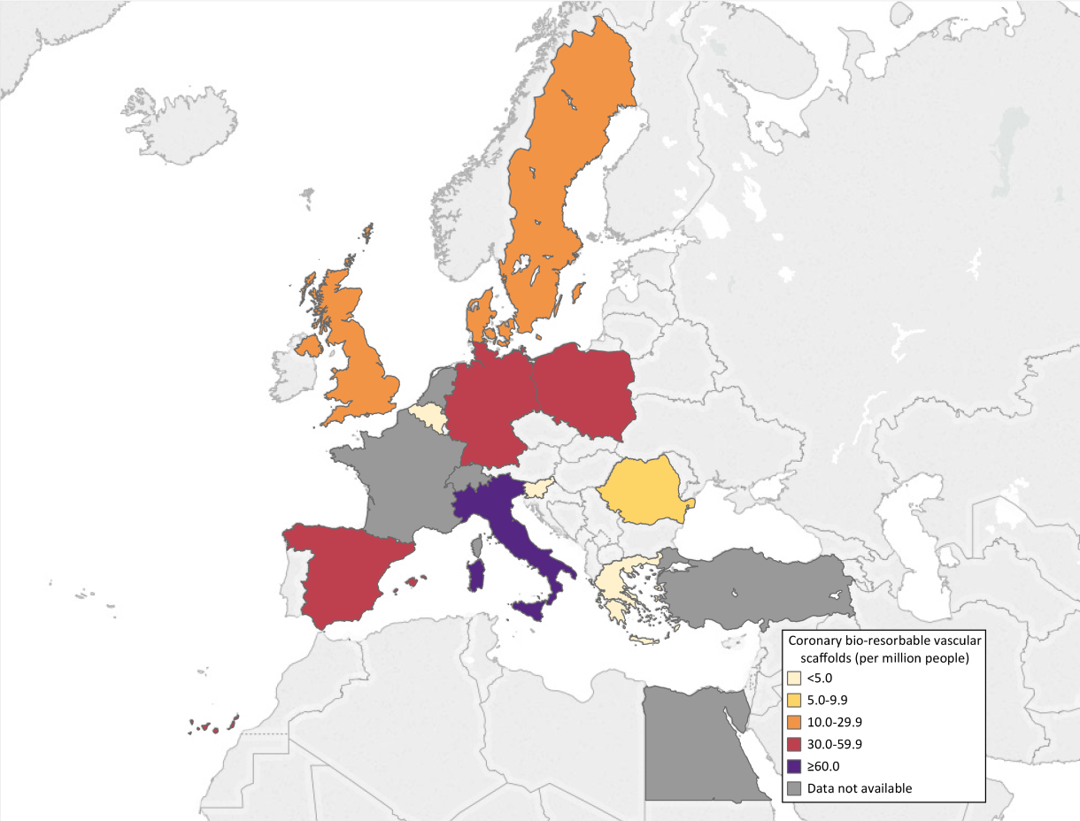
Coronary bio-resorbable vascular scaffolds (per million people), 2016
Source: Data on coronary bio-resorbable vascular scaffolds are from the EAPCI White Book database, 2016, data on file. Data unavailable: Egypt, Switzerland, Turkey. Notes: Spain: This is the number of procedures with at least one bio-resorbable vascular scaffold implanted; France: Procedure is no longer available in the country; Greece: Extrapolation based on data representing 97% of total; Netherlands: Procedure is no longer available in the country; Romania: Value covers 94% of the public and private interventional cardiology centers in the country.

Slide 59
Adjunctive intracoronary imaging techniques (per million people), 2016
Source: Data on adjunctive intracoronary imaging techniques are from the EAPCI White Book database, 2016, data on file. Data unavailable: Belgium, France, Netherlands, Turkey. Notes: Greece: Extrapolation based on data representing 97% of total; Italy: IVUS+OCT; Romania: Value covers 94% of the public and private interventional cardiology centers in the country.

Slide 60
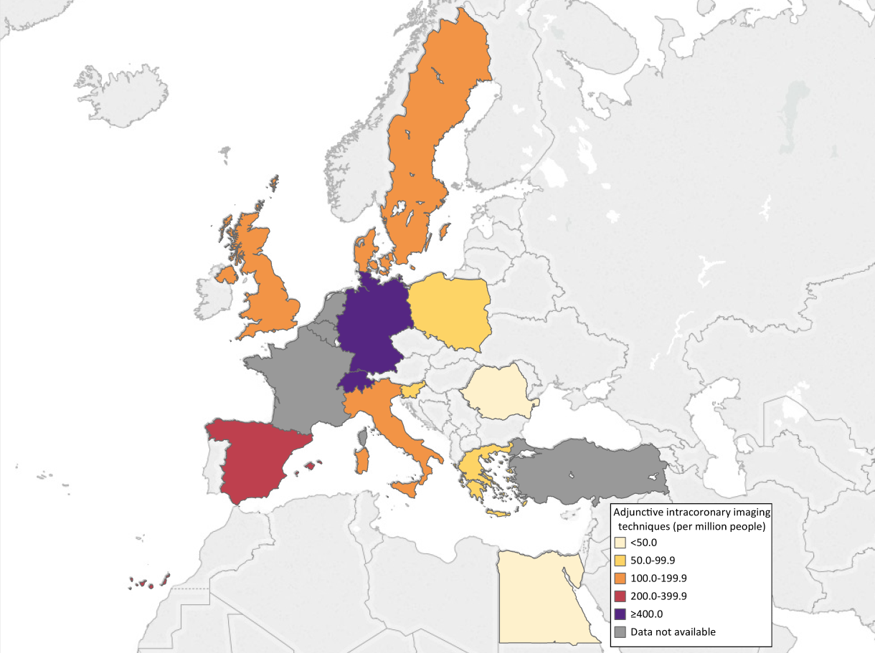
Adjunctive intracoronary imaging techniques (per million people), 2016
Source: Data on adjunctive intracoronary imaging techniques are from the EAPCI White Book database, 2016, data on file. Data unavailable: Belgium, France, Netherlands, Turkey. Notes: Greece: Extrapolation based on data representing 97% of total; Italy: IVUS+OCT; Romania: Value covers 94% of the public and private interventional cardiology centers in the country.

Slide 61
Percutaneous coronary interventions (PCI) performed with adjunctive intracoronary imaging techniques (per million people), 2016
Source: Data on percutaneous coronary interventions (PCI) performed with adjunctive intracoronary imaging techniques (per million people) are from the EAPCI White Book database, 2016, data on file. Data unavailable: Belgium, France, Germany, Italy, Netherlands, Romania, Spain, Switzerland, Turkey, Egypt. Notes: Greece: Extrapolation based on data representing 97% of total.

Slide 62
Percutaneous coronary interventions (PCI) performed with adjunctive intracoronary imaging techniques (per million people), 2016
Source:
Source: Data on percutaneous coronary interventions (PCI) performed with adjunctive intracoronary imaging techniques (per million people) are from the EAPCI White Book database, 2016, data on file. Data unavailable: Belgium, France, Germany, Italy, Netherlands, Romania, Spain, Switzerland, Turkey, Egypt. Notes: Greece: Extrapolation based on data representing 97% of total.

Slide 63
Adjunctive intracoronary physiology measurements (per million people), 2016
Source: Data on adjunctive intracoronary physiology measurements are from the EAPCI White Book database, 2016, data on file. Data unavailable: Belgium, Netherlands, Switzerland, Turkey. Notes: France: It doesn't include all centers; Greece: Extrapolation based on data representing 97% of total; Italy: FFR; Romania: The value covers 94% of the public and private interventional cardiology centers in the country.

Slide 64
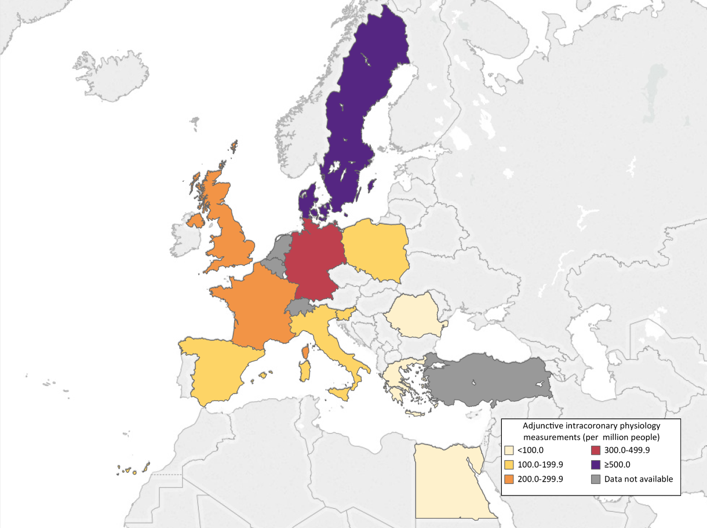
Adjunctive intracoronary physiology measurements (per million people), 2016
Source: Data on adjunctive intracoronary physiology measurements are from the EAPCI White Book database, 2016, data on file. Data unavailable: Belgium, Netherlands, Switzerland, Turkey. Notes: France: It doesn't include all centers; Greece: Extrapolation based on data representing 97% of total; Italy: FFR; Romania: The value covers 94% of the public and private interventional cardiology centers in the country.

Slide 65
Percutaneous coronary interventions (PCI) performed with adjunctive intracoronary physiology measurements (per million people), 2016
Source: Data on percutaneous coronary interventions (PCI) performed with adjunctive intracoronary physiology measurements are from the EAPCI White Book database, 2016, data on file. Data unavailable: France, Germany, Italy, Netherlands, Romania, Spain, Switzerland, Turkey. Notes: Greece: Extrapolation based on data representing 97% of total.

Slide 66
PCI performed with adjunctive intracoronary physiology measurements (per million people), 2016
Source: Data on percutaneous coronary interventions (PCI) performed with adjunctive intracoronary physiology measurements are from the EAPCI White Book database, 2016, data on file. Data unavailable: France, Germany, Italy, Netherlands, Romania, Spain, Switzerland, Turkey. Notes: Greece: Extrapolation based on data representing 97% of total.

Slide 67
Adjunctive intracoronary imaging techniques (per million) versus percutaneous coronary interventions (PCI) performed with adjunctive intracoronary imaging techniques (per million), 2016 or latest year
The two bars are overlapping, they both start at zero. 1) Adjunctive intracoronary imaging techniques. Source: EAPCI White Book database, 2016, data on file. Data unavailable: Belgium, France, Netherlands, Turkey. Notes: Greece: Extrapolation based on data representing 97% of total. 2) Percutaneous coronary interventions (PCI) performed with adjunctive intracoronary imaging techniques. Source: EAPCI White Book database, 2016, data on file. Data unavailable: Belgium, France, Germany, Italy, Netherlands, Romania, Spain, Switzerland, Turkey, Egypt. Notes: Greece: Extrapolation based on data representing 97% of total.

Slide 68
Adjunctive intracoronary physiology measurements (per million) versus PCI performed with adjunctive intracoronary physiology measurements (per million), 2016 or latest year
The total length of the bar indicates Adjunctive intracoronary physiology measurements (per million people). 1) Adjunctive intracoronary physiology measurements. Source: EAPCI White Book database, 2016, data on file. Data unavailable: France, Germany, Italy, Netherlands, Romania, Spain, Switzerland, Turkey. Notes: Greece: Extrapolation based on data representing 97% of total. 2) PCI performed with adjunctive intracoronary physiology measurements. Source: EAPCI White Book database, 2016, data on file. Data unavailable: France, Germany, Italy, Netherlands, Romania, Spain, Switzerland, Turkey. Notes: Greece: Extrapolation based on data representing 97% of total.

Slide 69
Percutaneous coronary interventions (PCI) with rotational or orbital atherectomy (per million people), 2016 or latest year
Source: Data on percutaneous coronary interventions (PCI) with rotational or orbital atherectomy are from the EAPCI White Book database, 2016 (except Germany: 2015), data on file. Data unavailable: Belgium, Netherlands, Turkey. Notes: Egypt: Procedure/resource not available in the country; Greece: Extrapolation based on data representing 97% of total; Romania: Value covers 94% of the public and private interventional cardiology centers in the country.

Slide 70
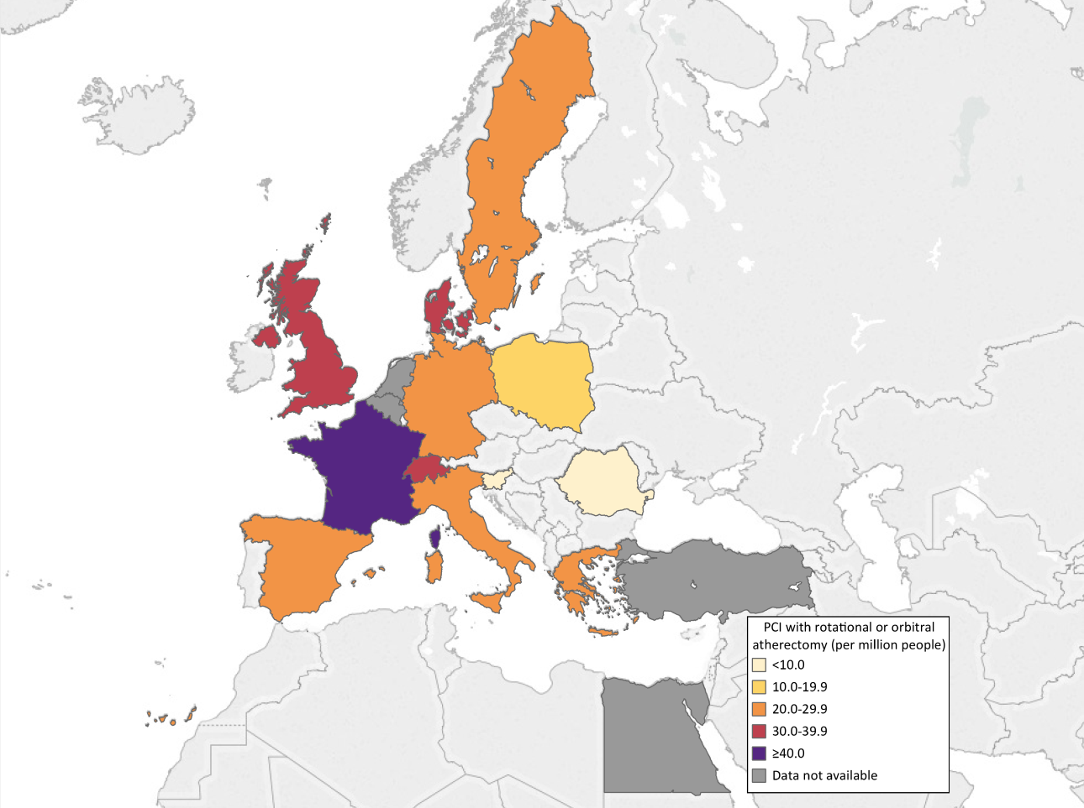
PCI with rotational or orbital atherectomy (per million people), 2016 or latest year
Source: Data on percutaneous coronary interventions (PCI) with rotational or orbital atherectomy are from the EAPCI White Book database, 2016 (except Germany: 2015), data on file. Data unavailable: Belgium, Netherlands, Turkey. Notes: Egypt: Procedure/resource not available in the country; Greece: Extrapolation based on data representing 97% of total; Romania: Value covers 94% of the public and private interventional cardiology centers in the country.

Slide 71
Use of hemodynamic support devices (per million people), 2016 or latest year
Source: Data on the use of hemodynamic support devices are from the EAPCI White Book database, 2016 (except Germany: 2015) data on file. Data unavailable: Belgium, France, Germany, Netherlands, Poland, Romania, Turkey. Notes: Greece: Extrapolation based on data representing 97% of total; Italy : IAPB+IMPELLA+ECMO+LVAD; UK: It doesn't include Autopulse or Lucas.

Slide 72
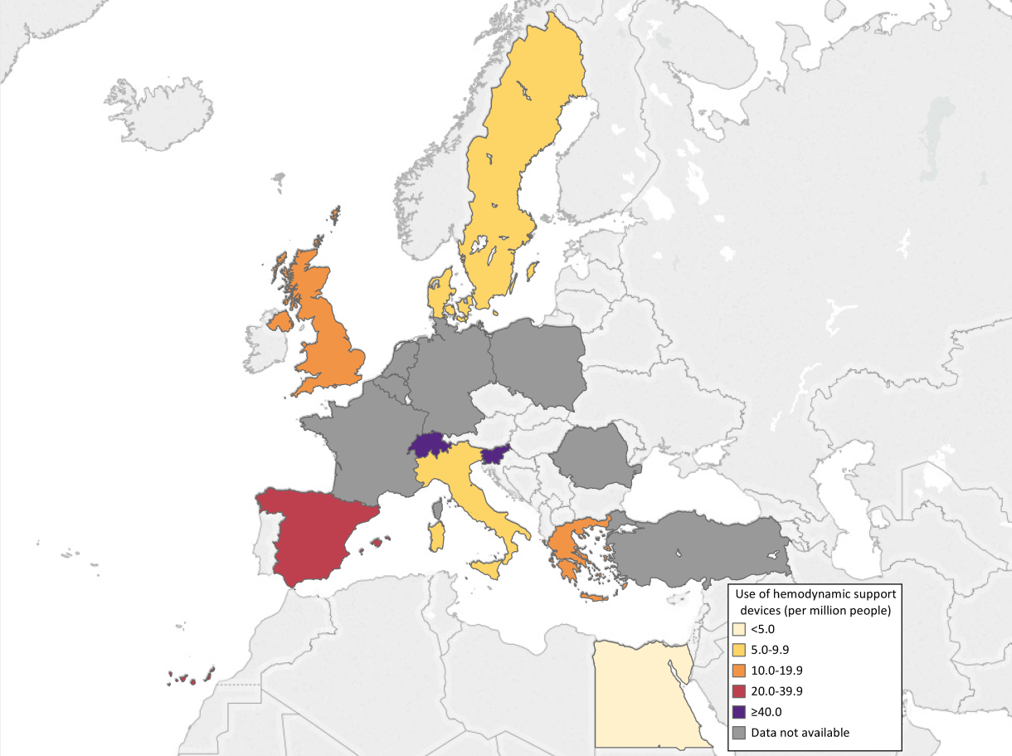
Use of hemodynamic support devices (per million people), 2016 or latest year
Source: Data on the use of hemodynamic support devices are from the EAPCI White Book database, 2016 (except Germany: 2015) data on file. Data unavailable: Belgium, France, Germany, Netherlands, Poland, Romania, Turkey. Notes: Greece: Extrapolation based on data representing 97% of total; Italy : IAPB+IMPELLA+ECMO+LVAD; UK: It doesn't include Autopulse or Lucas.

Slide 73
Procedures and resources for structural heart disease interventions

Slide 74
Alcohol septum ablations (per million people), 2016 or latest year
Source: Data on the alcohol septum ablations are from the EAPCI White Book database, 2016 (except Poland: 2015) data on file. Data unavailable: Belgium, France, Italy, Netherlands, Romania, Turkey. Notes: Egypt: Procedure/resource not available in the country; Sweden: Estimated value, partially extrapolated from 2015.

Slide 75
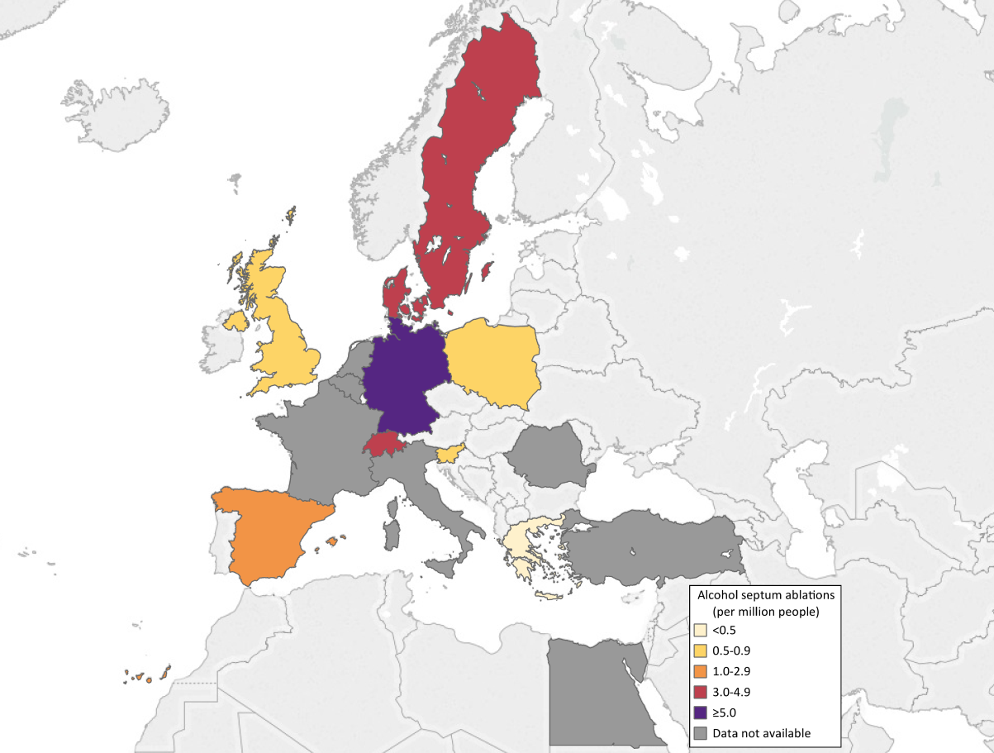
Alcohol septum ablations (per million people), 2016 or latest year
Source: Data on the alcohol septum ablations are from the EAPCI White Book database, 2016 (except Poland: 2015) data on file. Data unavailable: Belgium, France, Italy, Netherlands, Romania, Turkey. Notes: Egypt: Procedure/resource not available in the country; Sweden: Estimated value, partially extrapolated from 2015.

Slide 76
Mitral balloon valvuloplasties (per million people), 2016
Source: Data on mitral balloon valvuloplasties are from the EAPCI White Book database, 2016, data on file. Data unavailable: Belgium, Denmark, France, Netherlands, Romania, Turkey. Notes: Sweden: Estimated value, partially extrapolated from 2015.

Slide 77
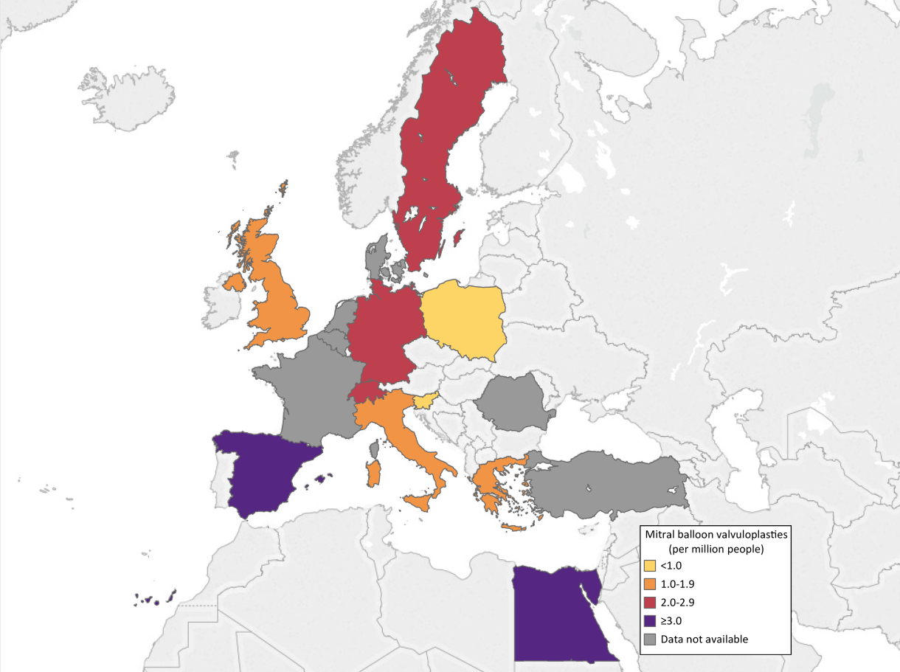
Mitral balloon valvuloplasties (per million people), 2016
Source: Data on mitral balloon valvuloplasties are from the EAPCI White Book database, 2016, data on file. Data unavailable: Belgium, Denmark, France, Netherlands, Romania, Turkey. Notes: Sweden: Estimated value, partially extrapolated from 2015.

Slide 78
Mitral valve percutaneous repairs (per million people), 2016 or latest year
Source: Data on mitral valve percutaneous repairs are from the EAPCI White Book database, 2016 (except Poland: 2017), data on file. Data unavailable: Netherlands, Turkey. Notes: Egypt: Procedure/resource not available in the country; France: It includes only procedures with Mitraclip; Sweden: Estimated value, partially extrapolated from 2015.

Slide 79
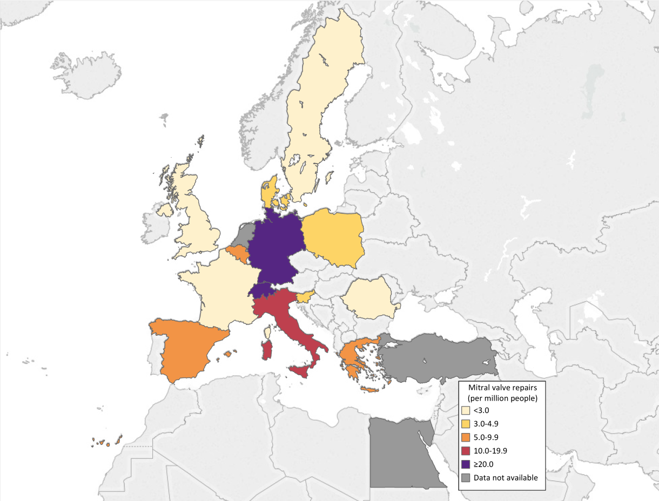
Mitral valve percutaneous repairs (per million people), 2016 or latest year
Source: Data on mitral valve percutaneous repairs are from the EAPCI White Book database, 2016 (except Poland: 2017), data on file. Data unavailable: Netherlands, Turkey. Notes: Egypt: Procedure/resource not available in the country; France: It includes only procedures with Mitraclip; Sweden: Estimated value, partially extrapolated from 2015.

Slide 80
Aortic balloon valvuloplasties (per million people), 2016 or latest year
Source: Data on aortic balloon valvuloplasties are from the EAPCI White Book database, 2016 (except Poland: 2015), data on file. Data unavailable: Belgium, France, Netherlands, Romania, Sweden, Turkey. Notes: Egypt: Procedure/resource not available in the country. UK: It includes only valvuloplasties that are not part of TAVI.

Slide 81
Aortic balloon valvuloplasties (per million people), 2016 or latest year
Source: Data on aortic balloon valvuloplasties are from the EAPCI White Book database, 2016 (except Poland: 2015), data on file. Data unavailable: Belgium, France, Netherlands, Romania, Sweden, Turkey. Notes: Egypt: Procedure/resource not available in the country. UK: It includes only valvuloplasties that are not part of TAVI.

Slide 82
Transcatheter aortic valve implantations (transvascular and transapical) (per million people), 2016 or latest year
Source: Data on the transcatheter aortic valve implantations (transvascular and transapical) is from the EAPCI White Book database, 2016, data on file.

Slide 83
Transcatheter aortic valve implantations (transvascular and transapical) (per million people), 2016 or latest year
Source: Data on the transcatheter aortic valve implantations (transvascular and transapical) is from the EAPCI White Book database, 2016, data on file.

Slide 84
Percutaneous transvascular aortic valve implantations (per million people), 2016 or latest year
Source: Data on the percutaneous transvascular aortic valve implantations are from the EAPCI White Book database (Italy: ESC Atlas of Cardiology database), 2016, data on file. Data unavailable: Belgium, Netherlands, Romania. Notes: Egypt: Procedure/resource not available in the country.

Slide 85
Percutaneous transvascular aortic valve implantations (per million people), 2016 or latest year
Source: Data on the percutaneous transvascular aortic valve implantations is from the EAPCI White Book database (Italy: ESC Atlas of Cardiology database), 2016, data on file. Data unavailable: Belgium, Netherlands, Romania. Notes: Egypt: Procedure/resource not available in the country.

Slide 86
TAVI (transvascular and transapical) (per million) versus percutaneous transvascular aortic valve implantations (per million), 2016 or latest year
The two bars are overlapping, they both start at zero. 1) Percutaneous transvascular aortic valve implantations. Source: EAPCI White Book database (Italy: ESC Atlas of Cardiology database), 2016, data on file. Data unavailable: Netherlands, Romania, Belgium. Notes: Egypt: Procedure/resource not available in the country. 2) Transcatheter aortic valve implantations (transvascular and transapical) . Source: EAPCI White Book database, 2016, data on file.

Slide 87
Peri-valvular leaks closures (per million people), 2016 or latest year
Source: Data on peri-valvular leaks closures are from the EAPCI White Book database, 2016 (except Poland: 2015), data on file. Data unavailable: Belgium, Egypt, France, Denmark, Netherlands, Romania, Turkey. Notes: Sweden: Estimated value, partially extrapolated from 2015.

Slide 88
Peri-valvular leaks closures (per million people), 2016 or latest year
Source: Data on peri-valvular leaks closures are from the EAPCI White Book database, 2016 (except Poland: 2015), data on file. Data unavailable: Belgium, Egypt, France, Denmark, Netherlands, Romania, Turkey. Notes: Sweden: Estimated value, partially extrapolated from 2015.

Slide 89
Valve-in-valve percutaneous implantations (per million people), 2016 or latest year
Source: Data on valve-in-valve percutaneous implantations are from the EAPCI White Book database, 2016, data on file. Data unavailable: Belgium, Egypt, France, Germany, Netherlands, Romania, Switzerland, Turkey. Notes: Egypt: Procedure/resource not available in the country.

Slide 90
Valve-in-valve percutaneous implantations (per million people), 2016 or latest year
Source: Data on valve-in-valve percutaneous implantations are from the EAPCI White Book database, 2016, data on file. Data unavailable: Belgium, Egypt, France, Germany, Netherlands, Romania, Switzerland, Turkey. Notes: Egypt: Procedure/resource not available in the country.

Slide 91
Procedure with cerebral embolic protection devices (per million people), 2016 or latest year
Source: Data on procedure with cerebral embolic protection devices are from the EAPCI White Book database, 2016, data on file. Data unavailable: Belgium, Denmark, France, Germany, Netherlands, Romania, Spain, Sweden. Notes: Procedure/resource not available in the country: Egypt, Greece, Poland, Turkey

Slide 92
Procedure with cerebral embolic protection devices (per million people), 2016 or latest year
Source: Data on procedure with cerebral embolic protection devices are from the EAPCI White Book database, 2016, data on file. Data unavailable: Belgium, Denmark, France, Germany, Netherlands, Romania, Spain, Sweden. Notes: Procedure/resource not available in the country: Egypt, Greece, Poland, Turkey.

Slide 93
Atrial septum closures (per million people), 2016 or latest year
Source: Data on atrial septum closures (per million people) are from the EAPCI White Book database, 2016, data on file. Data unavailable: Belgium, Netherlands, Romania, Turkey. Notes: Italy: PFO+DIA/ASD; Poland: Value based on 95% of the hospitals, pediatric centers are not included; Sweden: Estimated value, partially extrapolated from 2015.

Slide 94
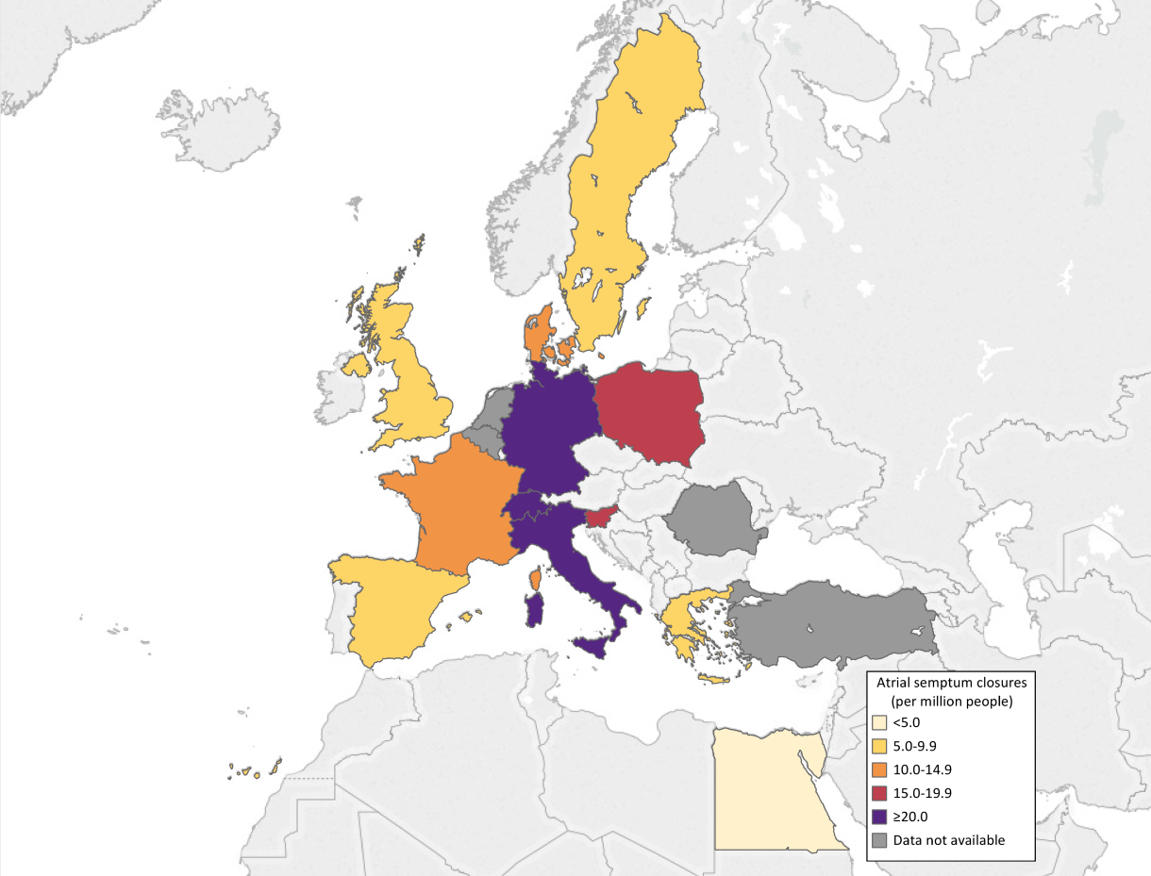
Atrial septum closures (per million people), 2016 or latest year
Source: Data on atrial septum closures (per million people) are from the EAPCI White Book database, 2016, data on file. Data unavailable: Belgium, Netherlands, Romania, Turkey. Notes: Italy: PFO+DIA/ASD; Poland: Value based on 95% of the hospitals, pediatric centers are not included; Sweden: Estimated value, partially extrapolated from 2015.

Slide 95
Ventricular septum closures (per million people), 2016 or latest year
Source: Data on ventricular septum closures are from the EAPCI White Book database, 2016, data on file. Data unavailable: Belgium, Denmark, Egypt, France, Italy, Netherlands, Romania, Sweden. Notes: Poland: Value based on 95% of the hospitals, pediatric centers also not included; Turkey: Procedure/resource not available in the country.

Slide 96
Ventricular septum closures (per million people), 2016 or latest year
Source: Data on ventricular septum closures are from the EAPCI White Book database, 2016, data on file. Data unavailable: Belgium, Denmark, Egypt, France, Italy, Netherlands, Romania, Sweden. Notes: Poland: Value based on 95% of the hospitals, pediatric centers also not included; Turkey: Procedure/resource not available in the country.

Slide 97
Left atrial appendage occlusions (per million people), 2016 or latest year
Source: Data on left atrial appendage occlusions are from the EAPCI White Book database, 2016 (except Poland: 2015), data on file. Data unavailable: Egypt, Netherlands, Romania, Turkey. Notes: Italy: It does not include part of the procedures done in EP units; Sweden: Estimated value, partially extrapolated from 2015.

Slide 98
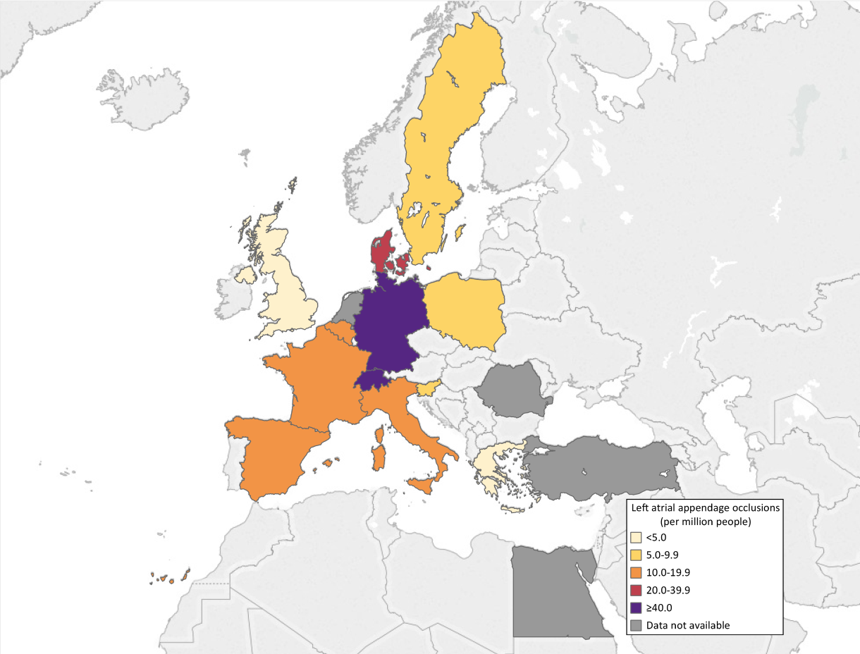
Left atrial appendage occlusions (per million people), 2016 or latest year
Source: Data on left atrial appendage occlusions are from the EAPCI White Book database, 2016 (except Poland: 2015), data on file. Data unavailable: Egypt, Netherlands, Romania, Turkey. Notes: Italy: It does not include part of the procedures done in EP units; Sweden: Estimated value, partially extrapolated from 2015.

Slide 99
Interventional cardiologists per total cath lab tables, 2016 or latest year
The indicator is computed as the ratio between the number of interventional cardiologists and the number of total cath lab tables 1) Interventional cardiologists. Source: Data on interventional cardiologists are from the EAPCI White Book database (except Italy: ESC Atlas of Cardiology database), 2016 (except Germany: 2015; Switzerland: 2017), data on file. 2) Total cath lab tables . Source: EAPCI White Book database, 2016 (except Turkey: 2017), data on file. Data unavailable: Belgium, Netherlands, Poland, Slovenia.

Slide 100
Percutaneous coronary interventions (PCI) per
total cath lab tables, 2016 or latest year
The indicator is computed as the ratio between the total number of PCI and the total number of cath lab tables. 1) PCI. Source: EAPCI White Book database, 2016 (except Germany: 2015; Slovenia, Turkey: 2017), data on file. Notes: Greece: Extrapolation based on data representing 97% of total; Romania: Value covers 94% of the public and private interventional cardiology centers in the country. 2) Total cath lab tables. Source: EAPCI White Book database, 2016 (except urkey: 2017), data on file. Data unavailable: Belgium, Netherlands, Poland, Slovenia.

Slide 101
TAVI (transvascular and transapical) per hospitals with cath labs performing TAVI, 2016 or latest year
The indicator is computed as the ratio between the total number of TAVI (transvascular and transapical) and the total number of hospitals with cath labs performing TAVI. 1) TAVI. Source: EAPCI White Book database, 2016, data on file. 2) Hospitals with cath labs performing TAVI. Source: EAPCI White Book database, 2016, (except Germany: 2015; Turkey: 2017), data on file.

Slide 102
Percutaneous transvascular aortic valve implantations per hospitals with cath labs performing TAVI (2016 or latest year)
The indicator is computed as the ratio between the percutaneous transvascular aortic valve implantations and the total number of hospitals with cath labs performing TAVI. 1) Percutaneous transvascular aortic valve implantations. Source: EAPCI White Book database (Italy: ESC Atlas of Cardiology database), 2016, data on file. Data unavailable: Belgium, Netherlands, Romania. Notes: Egypt: Procedure/resource not available in the country. 2) Hospitals with cath labs performing TAVI. Source: EAPCI White Book database, 2016, (except Germany: 2015; Turkey: 2017), data on file.

Slide 103
Hospitals with cathlabs (per million) versus hospitals with cathlabs performing TAVI (per million), 2016 or latest year
The two bars are overlapping, they both start at zero. 1) Hospitals with cath labs. Source: EAPCI White Book database, 2016 (except Netherlands, Turkey: 2017), data on file. Data unavailable: Germany 2) Hospitals with cathlabs performing TAVI (per million people). Source: EAPCI White Book database, 2016 (except Germany: 2015; Turkey: 2017), data on file.

Slide 104
Adjunctive intracoronary imaging techniques (per million) versus total number of PCI (per million), 2016
or latest year
1) Adjunctive intracoronary imaging techniques (per million people). Source: the EAPCI White Book database, 2016, data on file. Data unavailable: Belgium, France, Netherlands, Turkey. Notes: Greece: Extrapolation based on data representing 97% of total; Italy: IVUS+OCT; Romania: Value covers 94% of the public and private interventional cardiology centers in the country. 2)Percutaneous intracoronary imaging techniques (per million people). Source: the EAPCI White Book database, 2016 (except Germany: 2015; Slovenia, Turkey: 2017), data on file. Notes: Greece: Extrapolation based on data representing 97% of total; Romania: Value covers 94% of the public and private interventional cardiology centers in the country.

Slide 105
Adjunctive intracoronary imaging techniques versus
total diagnostic procedures, 2016 or latest year
1) Adjunctive intracoronary imaging techniques (per million people). Source: the EAPCI White Book database, 2016, data on file. Data unavailable: Belgium, France, Netherlands, Turkey. Notes: Greece: Extrapolation based on data representing 97% of total; Italy: IVUS+OCT; Romania: Value covers 94% of the public and private interventional cardiology centers in the country. 2) Diagnostic heart procedures (per million people). Source: the EAPCI White Book database, 2016 (except Germany: 2015; Turkey: 2017), data on file. Data unavailable: Belgium, Netherlands. Notes: Germany: Value includes only left heart catheterizations; Greece: Extrapolation based on data representing 97% of total; Romania: Value covers 94% of the public and private interventional cardiology centers in the country; Sweden: Value includes only coronary angiographies.

Slide 106
Adjunctive intracoronary physiology measurements versus total number of PCI, 2016 or latest year
1) Adjunctive intracoronary physiology measurements (per million people). Source: EAPCI White Book database, 2016, data on file. Data unavailable: Belgium, Netherlands, Switzerland, Turkey. Notes: France: It doesn't include all centers; Greece: Extrapolation based on data representing 97% of total; Italy: FFR; Romania: The value covers 94% of the public and private interventional cardiology centers in the country 2) Percutaneous coronary interventions (PCI) (per million people) are from the EAPCI White Book database, 2016 (except Germany: 2015; Slovenia, Turkey: 2017), data on file. Notes: Greece: Extrapolation based on data representing 97% of total; Romania: Value covers 94% of the public and private interventional cardiology centers in the country.

Slide 107
Adjunctive intracoronary physiology measurements
versus total diagnostic procedures, 2016 or latest year
1) Adjunctive intracoronary physiology measurements (per million people). Source: EAPCI White Book database, 2016, data on file. Data unavailable: Belgium, Netherlands, Switzerland, Turkey. Notes: France: It doesn't include all centers; Greece: Extrapolation based on data representing 97% of total; Italy: FFR; Romania: The value covers 94% of the public and private interventional cardiology centers in the country.
2) Diagnostic heart procedures (per million people). Source: the EAPCI White Book database, 2016 (except Germany: 2015; Turkey: 2017), data on file. Data unavailable: Belgium, Netherlands. Notes: Germany: Value includes only left heart catheterizations; Greece: Extrapolation based on data representing 97% of total; Romania: Value covers 94% of the public and private interventional cardiology centers in the country; Sweden: Value includes only coronary angiographies.

Slide 108
Definitions

Slide 109
Definitions
Hospitals with cath labs: hospitals, public or private, with one or more cath labs performing either diagnostic coronary angiographies or percutaneous coronary interventions (PCI), irrespective of whether the procedure occurs on an ambulatory basis or with overnight stay. If a hospital has more than one cath lab it is counted as one.
Total cath labs (tables): cath lab tables, public or private, performing either diagnostic coronary angiographies or percutaneous cardiovascular interventions (e.g PCI, TAVI). Please count the total number of lab tables, e.g. if a hospital has four cath lab tables the answer is four.
Hospitals with cath labs on 24 hours/7 days service: hospitals, public or private, with one or more cath labs performing urgent or primary percutaneous coronary interventions (pPCI) in patients with acute coronary syndromes (unstable angina, NSTEMI, STEMI) 24 hours a day, 7 days a week.

Slide 110
Definitions
Hospitals with cath labs and on-site cardiac surgery: total number of hospitals, public or private, with one or more cath labs performing either diagnostic coronary angiography or percutaneous coronary intervention, with an on-site cardiac surgery division. Please do not include the hospitals with remote surgery backup.
Hospitals with cath labs performing structural heart disease interventions in the adult: total number of hospitals, public or private, with one or more cath labs performing percutaneous transcatheter aortic valve implantations (TAVI), mitral and/or tricuspid valve interventions, left atrial appendage (LAA) closures, patent foramen ovale (PFO) closures, atrial ventricular defects (AVD) closures or septal ventricular defects (SVD) closures, with or without on-site cardiac surgery.
Hospitals with cath labs performing TAVI: total number of hospitals, public or private, with one or more cath labs performing percutaneous transcatheter aortic valve implantation (TAVI), with or without on-site cardiac surgery.

Slide 111
Definitions
Interventional cardiologists: total number of cardiologists able to perform as first operator either diagnostic coronary angiographies and/or percutaneous interventions.
Diagnostic heart procedures: total number of coronary angiographies and/or diagnostic (left and/or right ) heart catheterization.
Percutaneous coronary interventions (PCI): total number of coronary interventions including balloon angioplasties, with stent or scaffold implantation, including procedures that use coronary ablation techniques, etc.
Primary percutaneous coronary interventions (pPCI): total number of coronary interventions performed as first reperfusion therapy in patients with ST elevation myocardial infarction (STEMI).

Slide 112
Definitions
Percutaneous coronary interventions (PCI) in coronary with chronic total occlusions (CTO): total number of coronary interventions performed in coronary artery chronically occluded (for more than 3 months either angiographically documented or clinically suspected) both with antegrade or retrograde approach.
Percutaneous coronary interventions (PCI) in left main (LM) coronary artery: total number of coronary interventions performed in “unprotected” LM.
Percutaneous coronary interventions (PCI) for in-stent restenosis: total number of any coronary interventions in previously stented coronary segments.
Percutaneous coronary interventions (PCI) without stent: total number of coronary interventions without final stent and/or scaffold implantation.
Percutaneous coronary interventions (PCI) with drug-eluting balloons: total number of coronary interventions performed with the use of any kind of drug-eluting balloon.

Slide 113
Definitions
Coronary stents: total number of coronary metallic stents implanted.
Coronary drug-eluting stents: total number of coronary metallic drug-eluting stents implanted.
Coronary bio-resorbable vascular scaffolds: total number of coronary bio-resorbable vascular scaffolds (polymeric or metallic) implanted.
Adjunctive intracoronary imaging techniques : total number of overall coronary procedures (coronary angiography and PCI) performed with either intravascular ultrasound (IVUS), optical coherence tomography (OCT or OFDI), near infrared spectroscopy (NIRS), etc.
Percutaneous coronary interventions (PCI) performed with adjunctive intracoronary imaging techniques: total number of PCI performed with either intravascular ultrasound (IVUS), optical coherence tomography (OCT or OFDI), near infrared spectroscopy (NIRS), etc.

Slide 114
Definitions
Adjunctive intracoronary physiology measurements: total number of overall coronary procedures (coronary angiography and PCI) performed with either coronary flow reserve (CFR), fractional flow reserve (FFR), instantaneous wave free ratio (iFR), etc
Percutaneous coronary interventions (PCI) performed with adjunctive intracoronary physiology measurements: total number of PCI performed with either coronary flow reserve (CFR), fractional flow reserve (FFR), instantaneous wave free ration (iFR), etc.
Percutaneous coronary interventions (PCI) with rotational or orbital atherectomy: total number of PCI performed with adjunctive rotational or orbital atherectomy.
Use of hemodynamic support devices: total number of coronary angiographies or PCI performed in the cath lab with hemodynamic support devices like intra-aortic balloon pump (IABP), Impella, etc.

Slide 115
Definitions
Alcohol septum ablations: total number of percutaneous alcohol myocardial septum ablation performed in adult patients with left ventricular hypertrophy.
Mitral balloon valvuloplasties: total number of percutaneous mitral valve balloon dilatation performed in adult patients with mitral stenosis.
Mitral valve percutaneous repairs: total number of percutaneous mitral valve repair procedures in adult patients with mitral regurgitation (e.g. mitraclip, valve in prosthesis/ring, etc.)
Aortic balloon valvuloplasties: total number of percutaneous aortic valve balloon dilatation performed in adult patients.
Transcatheter aortic valve implantations (transvascular and transapical): total number of transvascular and transapical TAVI performed in adult patients

Slide 116
Definitions
Percutaneous transvascular aortic valve implantations: total number of percutaneous transvascular aortic valve implantations performed in adult patients.
Peri-valvular leaks closures: total number of percutaneous procedures with closing device implantation in peri-valvular prosthesis leaks.
Valve-in-valve percutaneous implantations: total number of percutaneous TAVI in patients with previous aortic bio-prosthesis (valve-in-valve) or with previous mitral valve ring (valve-in-ring).
Procedure with cerebral embolic protection devices: total number of percutaneous procedures (e.g. TAVI, etc.) performed with cerebral embolic protection devices.
Atrial septum closures: total number of percutaneous procedures performed in adult patients aiming at closing atrial septum defects, like patent foramen ovale (PFO) or atrial septum defect (ASD).

Slide 117
Definitions
Ventricular septum closures: total number of percutaneous procedures performed in adult patients aiming at closing ventricular septum defects (VSD).
Left atrial appendage occlusions: total number of percutaneous procedures performed in adult patients aiming at occluding left atrial appendage (LAA).

Slide 118
Disclaimer

Slide 119
Disclaimer
Despite best efforts to attain qualitative and complete data and despite the methodological steps outlined in the introduction, it must be acknowledged that, as is always the case with initiatives of this kind, data quality and credibility issues always exist, especially given that this is the first time that this project is undertaken. Over the years this exercise will improve and in consequence also the data quality and credibility.
Regardless, always data coming from a variety of sources across different countries should be viewed with caution. Also, differences between cardiac procedures may be caused by the fact that there are alternatives which may be used differently in different countries.
Therefore, it needs to be pointed out that, while indicators are presented and associated with each other for comparative purposes, it needs to be vividly noted that healthcare reality is very complex and simple comparisons should be viewed with caution and there are serious risks of misinterpretation if one neglects the simultaneous impacts of many different confounding factors which may determine the variables of interest.

Slide 120
Legal mentions

Slide 121
Legal mentions
The European Society of Cardiology (ESC) does its utmost to provide users with available and verified information and tools and shall not be liable for any errors, absence, unavailability of data of authorisation.
ESC shall not be liable for any unauthorised use of data collected from external sources by ESC members.
Data provided by ESC is for information purposes only. ESC cannot guarantee the correctness, accuracy, completeness and currency of data published on the website, nor its appropriateness to any user's requirements.
Users hereby confirm they are solely liable for the use made of the data available in this report.
Users undertake not to use the site services or any information to which they might have access for purposes that might conflict with public policy or common decency or infringe third party rights.

